Slide 1
Halewood Laboratories Pvt. Ltd.
Herbal Range
www.halewoodlabs.com

Slide 2
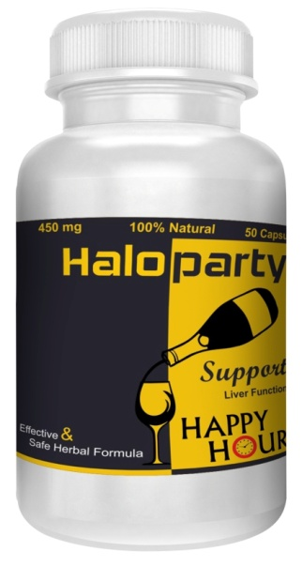
Haloparty
Haloparty is a natural supplement specially formulated to help reduce the hangover effects of alcohol.
It contains natural ingredients work together o provide your body with the nutrients you lose during your night of alcohol consumption.
It acts as a remedy to help your body recover from the hangover symptoms.
Dosage: 1 to 3 capsules with a glass of water before and after your alocholic drinks.
Packing: 50 capsules in a bottle.

Slide 3
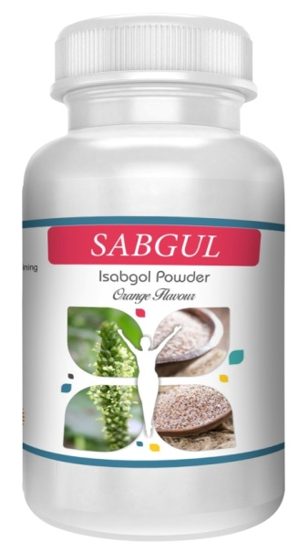
Sabgul (Psyllium Fibre)
Pysllium is a type of fiber commonly used as a gentle, bulk forming laxative.
It helps in maintaining blood sugar, reduces blood pressure, detoxifying the body, weight loss, cholesterol reduction.
Different combinations prepared are:
-Psyllium powder
-Psyllium with Effervescent
-Psyllium with Probiotic
-Psyllium with Effervescent and Probiotic.

Slide 4
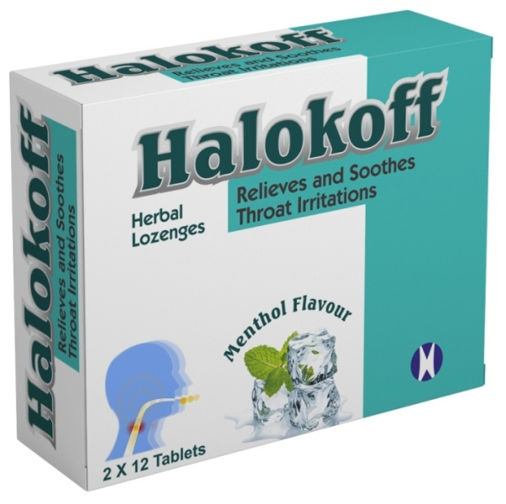
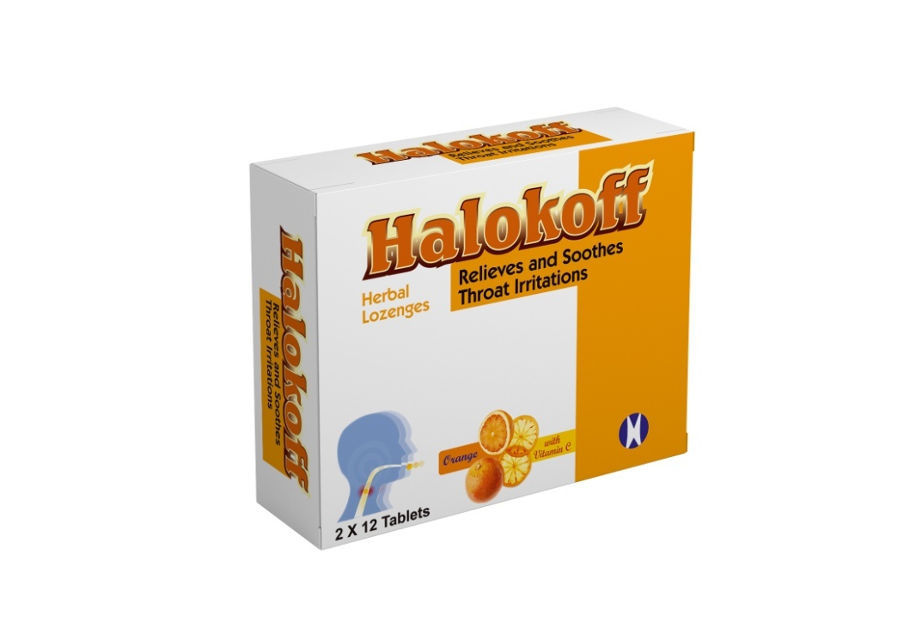
Halokoff (Herbal Lozenges)
Herbal Lozenges for cough and cold.
Different flavours of Halokoff to act more effectively:
-Menthol flavour
-Orange with Vitamin C
-Ginger and Lemon
-Honey and Lemon
-Cerise Noire
Phudina ke phool (menthol) | 4.00mg
Eucalyptus | 0.75mg
Camphor | 0.19mg
Thymol | 0.10mg
Malic acid(E296) | Q.S.
Sugar base | Q.S.

Slide 5
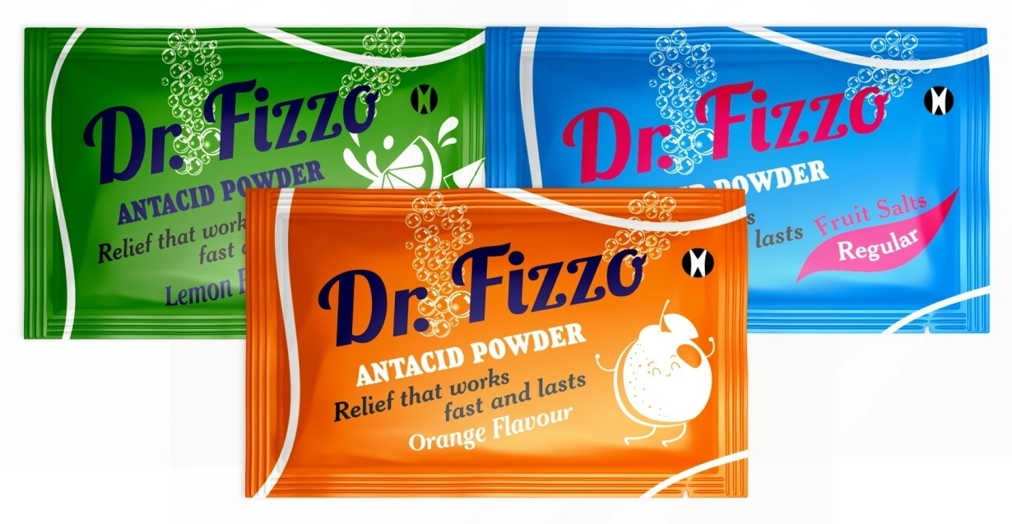
Dr. Fizzo
Dr. Fizzo is a fruit salt effervescent compounds made up of organic acids.
Benefits:
Provides instant relief from acidity, gastric
Discomfort and heartburn
Act as antacid used to decrease bloating.
Packing style:
Primary packing: 5gm sachet.
Flavours-
Regular, Lemon, Orange and Cola.
Composition:
Nimbu satva (Citrus madica) | 41.80%
Sajjikhar | 58.20%
Excipients | Q.S.
Sucralose (sweetner),
Colour sunset yellow FCF.

Slide 6
More variations in herbal range.
Senna Tablets
Herbal cold and cough granules
Male Libido capsules.

Slide 7
THANK YOU!

